Slide 1
18AU61
INTER-AXLE DIFFERENTIAL
Presented by:- RAGHAVENDRA H L(1AY18AU019)

Slide 2
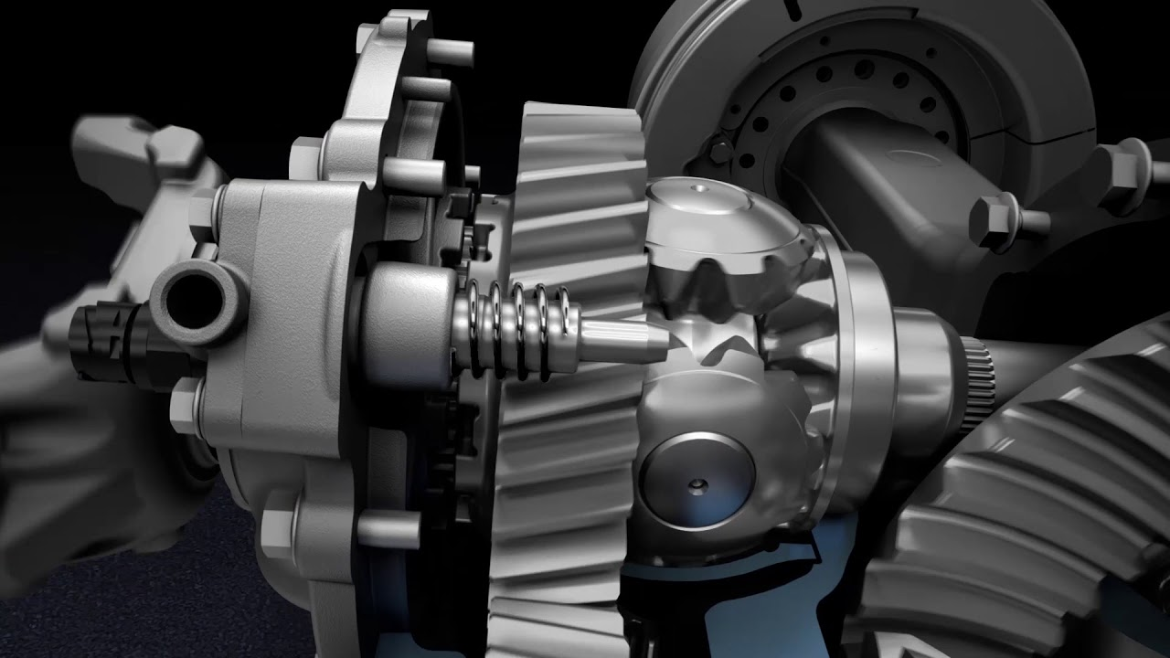
INTER-AXLE DIFFERENTIAL

Slide 3
WHAT IS AN INTER-AXLE DIFFERENTIAL?
An inter-axle differential (IAD) also known as Power divider is a separate differential box that locks the first and second differentials in a tandem truck.
The main purpose of using an inter-axle differential is to ensure that the tires on front and rear axles are moving at the same speed.

Slide 4
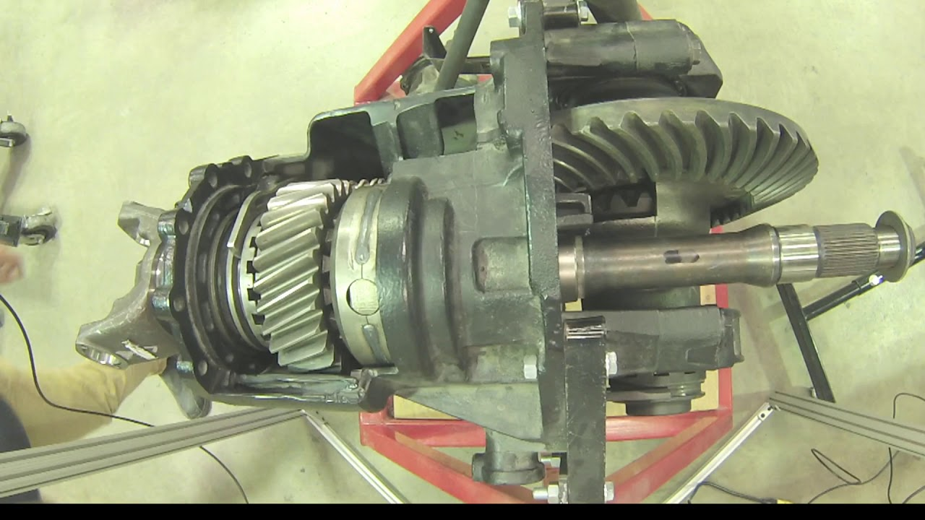

Slide 5
INTER-AXLE DIFFERENTIAL HAS TWO CONDITIONS
1.LOCK CONDITION:- When in locked condition the front and the rear drive axle drive at the same speed but not the torque , it can be varing. We are just making sure the wheels rotate at the same speed.
2.UNLOCK CONDITION:-When in unlocked condition the speed can be varied and the torque can be split between the front and the back.

Slide 6
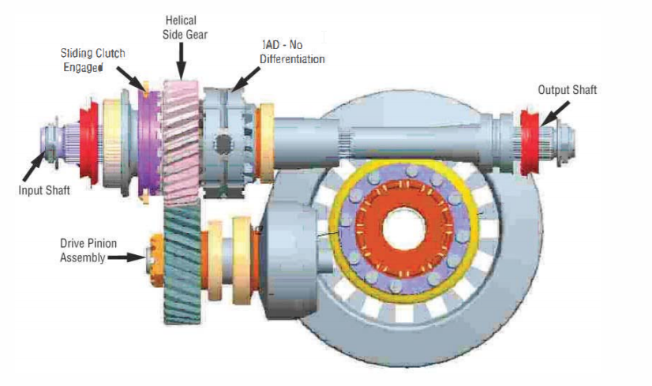
Locked condition

Slide 7
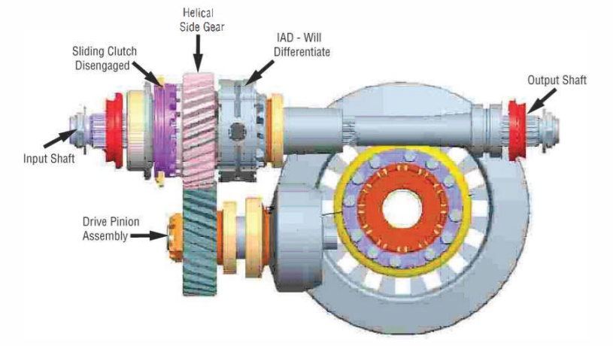
Unlock condition

Slide 8
IMPORTANT POINTS TO REMEMBER
➽The IAD is activated by the driver via a switch
➽The IAD helps protect power divider parts from spin out damage
➽The IAD directs available power to both axles
➽The IAD can be utilized at all speeds, but to reduce axle stress and excess tire wear, should be disengaged when not needed for added traction

Slide 9
THANKYOU
Thus by using an Inter-axle differential, spin out of the wheels can be significantly minimized!

